Slide 1
Contamination Control Solutions Breather Filters Oil Filtration
Wes Jones
General Sales Manager
Beach Filter Products
Hanover, PA

Slide 2
Contamination Control Business Growing over 25%/Year
Why?
75% of equipment failures due to lubricant contamination.
Water & particle contamination source:
70% through oil reservoir breather/filler cap
30% from new lubricant
Lubricant Contamination can be controlled
Filter new oil before use
Keep it clean and dry with a breather filter

Slide 3
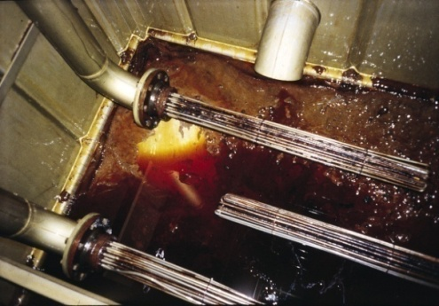
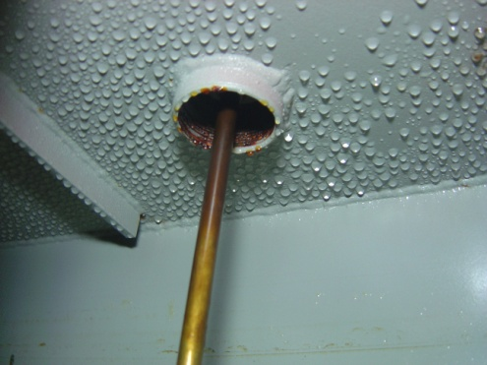
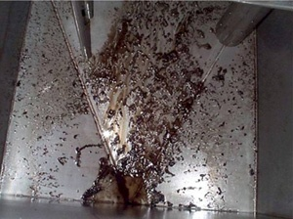
The Problem We Help Solve – Contamination
Lubricant contamination is a leading cause of machinery failure
Cost of removal = 10X cost of prevention
Contamination is responsible for as much as 75% of the wear that leads to mechanical failure
- 70% enters through the breather cap
- 30% from new oil
Particles cause 82% of wear in the 6 main industrial sectors in Canada – National Research Council of Canada
“Bearings can have an infinite life when particles larger than the lubricant film are removed.” – SKF
“Compared to 40-micron filtration…wear was reduced 70% with 15-micron filtration.” – General Motors through SAE
Proactive, Holistic Approach
Beach Filter Products
Notes:
Cost of removal – (self-explanatory) breathers are cheaper than oil filtration systems
Cont. Leading Cause – refer to the Natl Research Council of Canada in the box on the right
Turn the 80% around and explain that if 80% of the wear is due to contamination, that means only 20% of the money spent on the machine is being productive.
The SKF quote is directed at Journal bearings. Journal bearings, if properly lubricated, never make metal-to-metal contact. If the bearing is sized correctly and the oil kept clean, it can last forever.
Lastly, the GM/SAE stat is for a small-block 350. The motor lasted 8 times longer on the test stand by simply changing the oil filter.

Slide 4
Cleaner Oil = Up to 10X Better Reliability
© Copyright Noria Corporation, used with permission
Example: Improve particulate level from ISO code 21/18 to 14/11
Rolling Element bearings get 4.5 times more service life
Notes:
4
4

Slide 5
Less Water = Longer Equipment & Lubricant Life
Example: Improve moisture level from 500ppm to 100ppm
→ Rolling element bearings get 2.3 times more service life
© Copyright Noria Corporation, used with permission
Notes:
5
5

Slide 6
Beach: One-Stop Shop for Contamination Control
Lubrication Transformation Services
Quantify / Design | Execute | Educate | Monitor
From the Outside – In |  | From the Inside – Out
Standard Desiccant Breathers |  | Portable Filtration
Specialty Breathers |  | Filter Carts & Drum Filter Carts
Extreme Duty Breathers |  | Compact Filtration
Hybrid Breather-Aquaguard® |  | Dedicated Filtration:
Hybrid Breather-Aquaguard® V |  | Depth Filtration
Extended Series Breathers |  | Vacuum Dehydration & Water Separation
Rebuildable Steel Breathers |  | Lubricant Management Systems
Non-Desiccant Breathers |  | Custom Filtration
Adapter Kits |  | Adapter Kits
NEW Products
ISOLink Oil Transfer container |  | High Tech Pitcher for oil transfer
New

